Slide 1




Statistical Analysis of Apple Store Reviews
Presented By: Azam Mustufa

Slide 2



Project Goal
Analyze User Engagement and Satisfaction: "To investigate the factors that drive user engagement (likes) and satisfaction (ratings) with popular social media apps like Instagram and WhatsApp."
Comparative Analysis of App Performance: "To compare the user experience and reception of Instagram and WhatsApp based on key metrics such as ratings, likes, and purchase behavior."
Understanding User Behavior in Social Media Apps: "To explore user behavior patterns, including spending habits and content interaction (likes), and their relationship with app ratings."

Slide 3


Calculate the mean, median, and mode of the app ratings in the dataset. Which measure (mean, median, or mode) best represents the central tendency of the ratings?
Measure | Value
Mean | 2.9
Median | 3
Mode | 1
The median best represents the central tendency of ratings, as it is robust to outliers and appropriate for ordinal data.

Slide 4
Find the range and interquartile range (IQR) of the Purchase_Amount in the dataset. How do these values help in understanding the spread of the data?
Measure | Value
Range | 19.97
IQR | 10.19
Min, Max | 0, 19.97
Range shows overall spread including outliers, while IQR shows the spread of the middle 50% of data, less affected by outliers.

Slide 5


Calculate the variance and standard deviation for the number of likes received on reviews. What does the standard deviation indicate about the spread of the data?
Measure | Value
Variance | 2.15
Std. Deviation | 1.47
Variance and standard deviation have a difference of about 0.6 suggesting that data is clustered around mean and not spread out like `Purchase_Amount`

Slide 6
Determine the correlation between the likes and the rating given. Is there a positive, negative, or no correlation between these variables?
Measure | Value
Correaltion | 0.84
The correlation being almost close to 1 suggesting a strong relation between likes and rating which implicates that a larger population is facing the same problem on average.

Slide 7
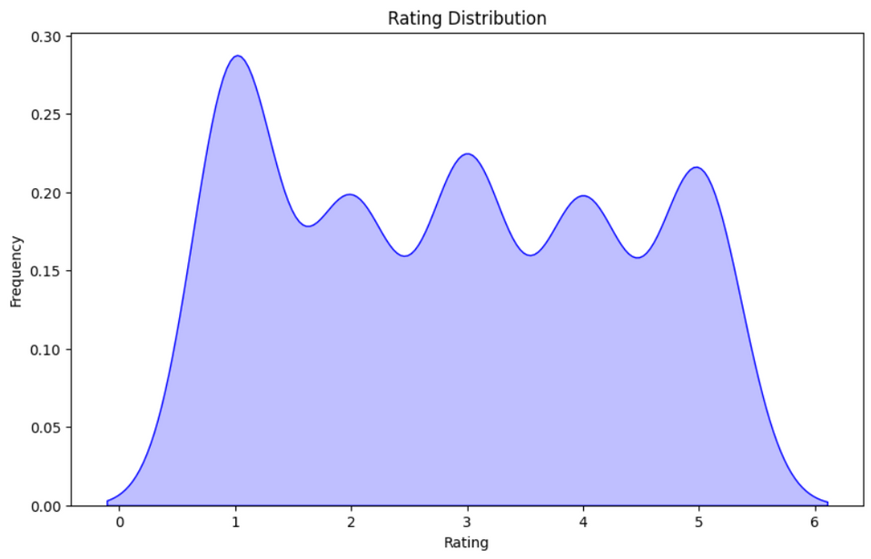
Plot the distribution of the app ratings. Is the distribution positively or negatively skewed? What does this indicate about user satisfaction?
The KDE plot indicates that most users are either dissatisfied (with lower ratings) or neutral (at a rating of 3), as it shows a higher concentration of ratings at 3 compared to 4 or 5. This suggests that users are generally more dissatisfied or indifferent rather than satisfied.

Slide 8
Perform a hypothesis test to determine if the average rating for Instagram is significantly higher than the average rating for WhatsApp. Use a 95% confidence level.
Null Hypothesis (H0) | Instagram’s rating is higher than Whatsapp’s
Alternate Hypothesis | No significant difference between Instagram’s rating and Whatsapps’s rating
Measure | Value
t-statistic | 0.796
p value | 0.213
Analysis shows no significant difference in average ratings between Instagram and WhatsApp (p=0.2132), thus we fail to reject the null hypothesis.

Slide 9
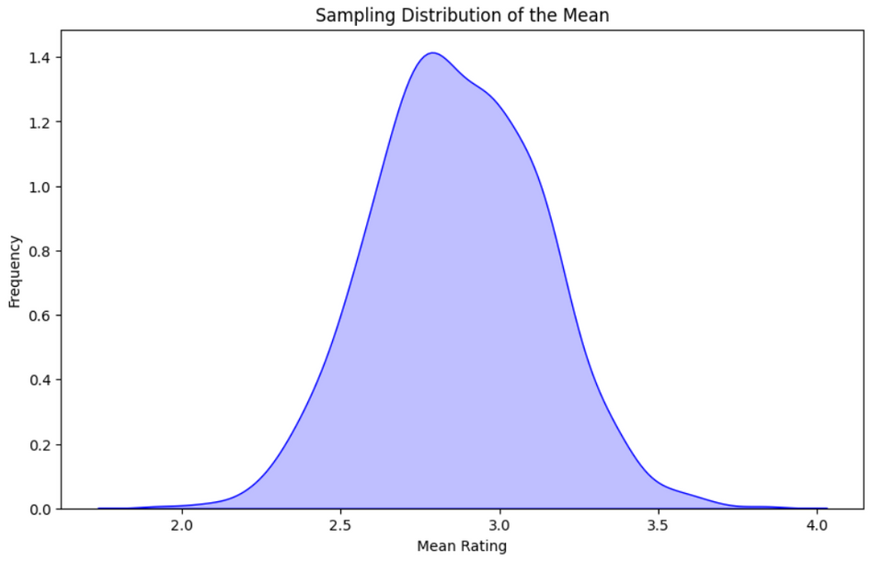
Take random samples of ratings from the dataset and calculate their means. Create a sampling distribution and explain how this relates to the Central Limit Theorem.
As the sample size increases, the sampling distribution of the sample means will approach a normal distribution, regardless of the shape of the original population distribution.

Slide 10



THANK YOU

